Slide 1



Diamante
Networking & Storage Prototype using P2P & Ledger Modules
TEAM NAME: TECHSENATE

Slide 2

About Project
Developed a prototype for the Diamante L1 blockchain stack.
Networking (P2P): Established a decentralized peer-to-peer network for node communication.
Storage (Ledger/State Machine): Managed immutable transaction records and maintained accurate state.
Implemented real-time transaction processing and data persistence.
Created a visual dashboard to monitor node interactions and ledger updates.

Slide 3
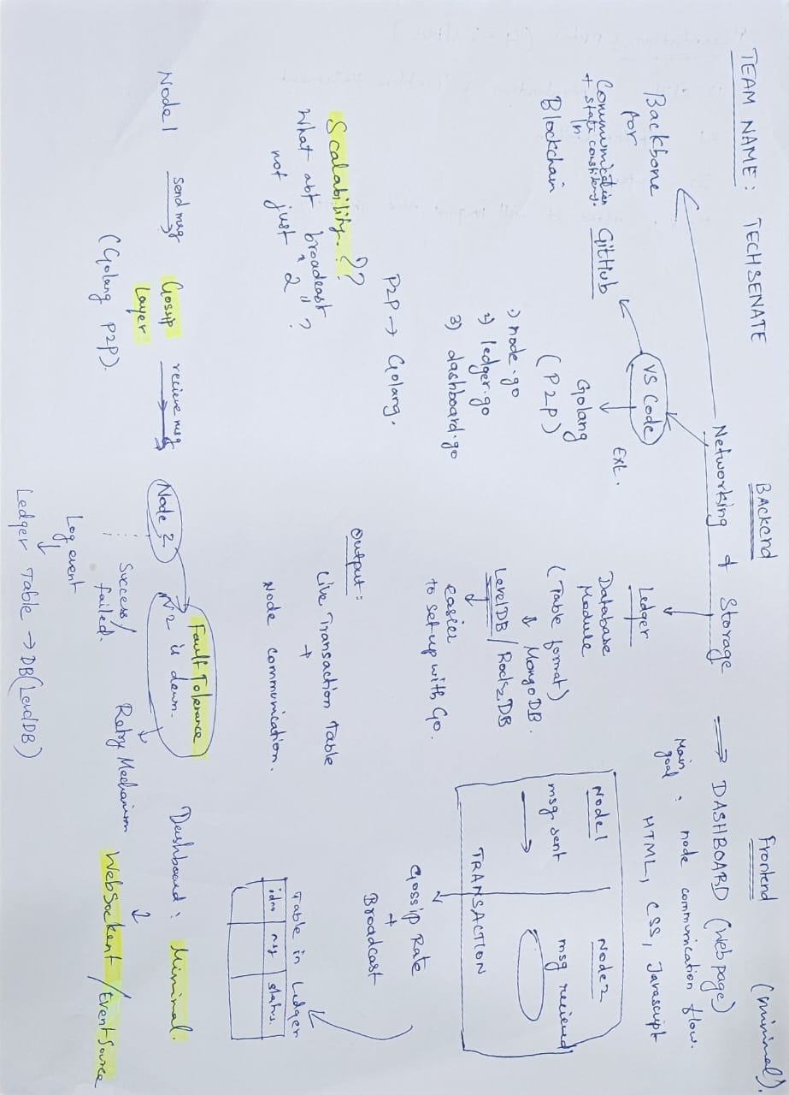
PLAN

Slide 4
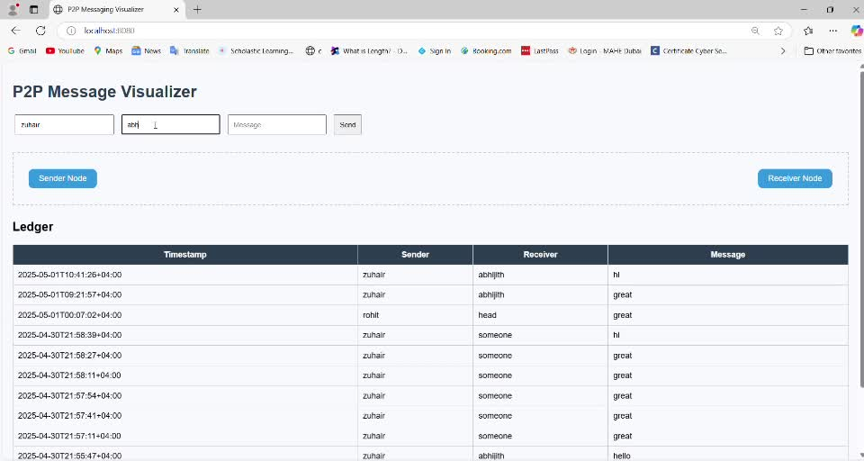
Demo Video

Slide 5


System Components:
Node 1: Sends transactions/messages.
Node 2: Receives and stores messages in LevelDB.
Server: Exposes stored data via REST API.
Dashboard: Displays live updates of node messages and ledger entries.​
Technologies Used:
GoLang for networking and database operations.
LevelDB for lightweight key-value storage.
HTML/CSS/JS for the frontend interface.

Slide 6
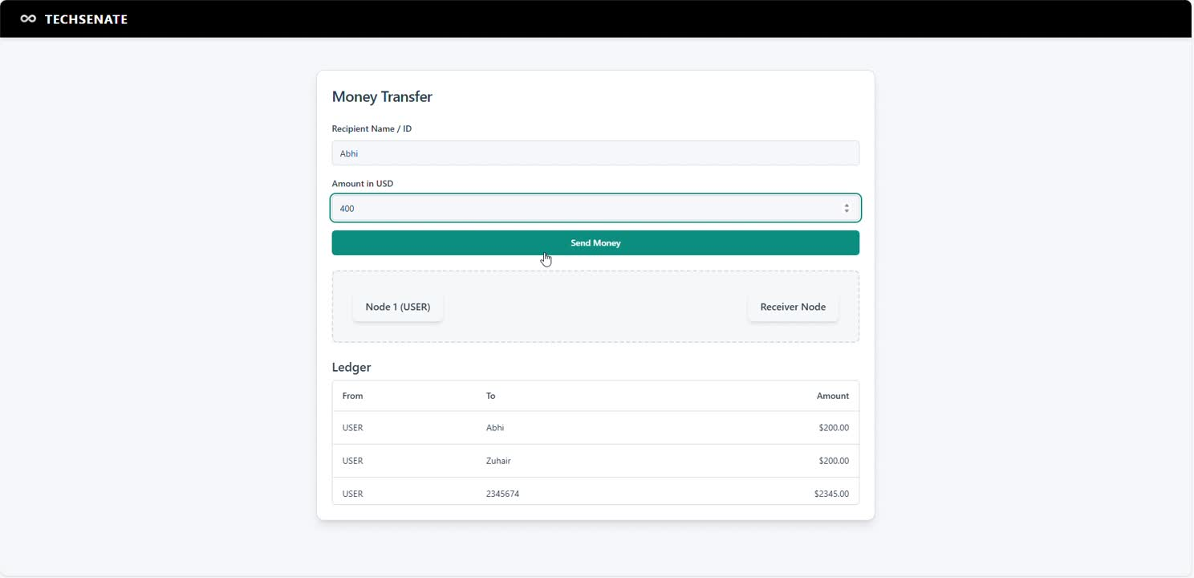
Real-world Application

Slide 7

Key Features & Outcomes
Simulated peer-to-peer node communication.
Real-time gossip message transmission.
Persistent storage using LevelDB.
Integrated API and frontend for seamless interaction.
Modular design separating nodes, server, and dashboard.
Outcome: Functional minimum viable product demonstrating node communication and ledger operations, providing a foundation for further enhancements like consensus mechanisms and scalability.​

Slide 8


Industry Impact
1. Faster & Reliable Blockchain Nodes
What it means: Blockchain networks consist of many nodes (computers) that store and verify transactions.
Impact: Improving their speed and reliability means transactions are processed quicker and the network is more stable.
Why it matters: This is essential for making blockchain systems scalable and user-friendly (e.g., faster payments).
2. Stronger Network Security
DoS Protection: Prevents "Denial of Service" attacks, which try to flood the network with fake traffic and shut it down.
Gossip Protocol: A method nodes use to spread information quickly and efficiently, like how rumors spread in a crowd.
Impact: Together, they make the network more secure and ensure all nodes stay updated reliably.
---
Let me know if you'd like this turned into a diagram or simplified even more!

Slide 9
3. Smarter Ledger Design (using LwDAP)
LwDAP: A framework or method that helps in analyzing and choosing the best structure for the blockchain ledger.
Ledger: A digital record of all transactions in the blockchain.
Impact: Leads to better organization, performance, and adaptability of the blockchain system.
4. Trends & Evolution Insight
What it does: Monitors and analyzes changes in the blockchain industry.
Impact: Helps companies and developers stay updated with new technologies, upgrades, or standards.
Why it matters: Staying ahead ensures competitiveness and innovation.

Slide 10
5. Testing & Simulation
Best-of-breed testing: Using top-quality tools to simulate real-world blockchain behavior.
Impact: Lets developers test their networks safely before launch, finding bugs or weaknesses early.
Why it matters: Prevents costly failures and improves user trust.
Web3 is a decentralized version of the internet, where users have control over their data, identities, and assets using blockchain technology.
1. Decentralization- No central authority (like Facebook or Google); instead, apps run on blockchains or peer-to-peer networks.
2. Ownership-Users truly own their data, digital items (like NFTs), and money (like crypto wallets).

Slide 11


Diamante
Thank
You
Team Members:
Zuhair Atham
Abhijit Lakshmandass
Anuraag
Rayn
Sajjad
Sahal
Abdul Kader
Thanks for this amazing opportunity! Diamante V2 Hackathon

